Slide 1

ReactJS
Component LifeCycle

Slide 2
3 Phases
Mount
Update
Unmount
Notes:
The first phase of the React Component life cycle is the Creation/Mounting phase. This is where we start initialization of the Component. At this phase, the Component's props and state are defined and configured. The Component and all its children are mounted on to the Native UI Stack (DOM, UIView, etc.). Finally, we can do post-processing if required. The Birth/Mounting phase only occurs once.
The next phase of the life cycle is the Update phase. In this phase, we get new props, change state, handle user interactions and communicate with the component hierarchy. This is where we spend most of our time in the Component's life. Unlike Birth or Death, we repeat this phase over and over.
The final phase of the life cycle is the Unmount phase. This phase occurs when a component instance is unmounted from the Native UI. This can occur when the user navigates away, the UI page changes, a component is hidden (like a drawer), etc. Death occurs once and readies the Component for Garbage Collection.

Slide 3

Hooks
React Developers
Notes:
The React development team provides a series of hooks we can tap into at each phase of the life cycle. These method hooks inform us of where the Component is in the life cycle and what we can and cannot do.
Each of the life cycle methods are called in a specific order and at a specific time. The methods are also tied to different parts of the life cycle

Slide 4
Mounting Hooks
Constuctor
getDerivedStateFromProps
render
componentDidMount
Notes:
constructor— in general, there are two reasons to use a React constructor:
Set up your components initial state
Bind event handler methods to an instance
getDerivedStateFromProps --- whenever your props change or your class based components, you can sync your state to them
render --- We create Elements (generally via JSX) and return them.
componentDidMount --- When this method is called we now have access to the Native UI (DOM, UIView, etc.)

Slide 5
Constructor
Constructor(props)
Props and state
Call super(props)
this.state not setState
Don’t cause Side-Effects
Notes:
1 - It is the default ES6 Class feature
2-
During the initialization of the Component from the Element, the props and state are defined.
Element instance contains the current props that are being passed to the Component instance. Most of the time, all the available props on the Component are not required. Yet, some times we do need to have values for all the props for our Component to render correctly.
React handles default props by merging the passed props object and the default props object.
Once the final props are defined (passed w/ defaults), the Component instance configures the initial state. This process occurs in the construction of the instance itself. Unlike props, the Component state is an internal object that is not defined by outside values.
3- calling super to move the props to the parent for initializing
4- remember this.state = , not setState cause there will be no state to merge this state with
5- Don’t cause side-effects: like http request, or storing something in browser, sending analytics to google analytics. This may effect performance and cause unnecessary re-render cycles .

Slide 6
getDerivedStateFromProps(props, state)
No This
Props changes
Update state
Don’t cause Side-Effects
getDerivedStateFromProps
Notes:
1- getDerivedStateFromProps is a static method which is invoked after a component is instantiated as well as when it receives new props.
2- you cannot access this inside this method neither you can access any other class method,
3-
whenever your props change or your class based components, you can sync your state to them
if you have scenario that props of your components can change, and you want to update internal state of that component , then use this hook
4- You should return your update state in here, so the only way to update state is returning an object. If you don’t want to update any state, simply return null.
5- Don’t send http request in this hook it will cause cycle and low performance.

Slide 7
render()
Return
Child Component
Don’t cause Side-Effects
render
Notes:
1- getDerivedStateFromProps is a static method which is invoked after a component is instantiated as well as when it receives new props.
2- That is the method that returns jsx as we know, you should use it only to prepare the data as you need it to lay out your jsx code and to render the html code.
Examines this.props and this.state to return one of the following:
- React Elements (JSX)
- Arrays and Fragments
- Portals
- Strings/numbers
- Booleans or null
3- All child components will be rendered here, If that was a class-based component we could add a lifesycle there too and see it run for all the clased-based component
After render runs and you render any other react components in this class-based component, then these child components will now be rendered.
So every child component you included in your rendered component here will then be rendered as well, and only once all child components were rendered and that their lifecycle hooks finished, your lifecycle. Your life cycle will finish for the creation when componentDidMount get called.
4- Don’t send http request or set timeouts, so nothing can block this rendering process

Slide 8
componentDidMount()
Cause Side-Effects ☺
componentDidMount
Notes:
1- this method runs immediately after the component output has been rendered to the DOM. It will not get run in node but will in the browser
2- it’s typical hook you would use for making http request to get new data from web, you shouldn’t do however update the state , so don’t call set state in here unless it is for example in then block of a promise after you sent an http request , but don’t call set state in here asynchronously, so don’t do it right away when componentDidMount runs do it in the response, cause that will also trigger re-render cycle which is bad for performance

Slide 9
Update Hooks
getDerivedStateFromProps
shouldComponentUpdate
getSnapshotBeforeUpdate
getSnapshotBeforeUpdate
componentDidUpdate

Slide 10
getDerivedStateFromProps(props, state)
Do
Don’t
getDerivedStateFromProps
Notes:
1- you would use it to initialize the state of a component that updates based on props you’re getting, so updated props you’re getting most likely that could be for example some form control which gets external properties and then you internally want to handle user input but initialize your state or update your state based on outside changes
2- Do: sync your local state inside of the component to your props you are getting
3- Don’t: send http requests or anything like that cause it will cause cycle and low performance

Slide 11
shouldComponentUpdate(nextProps, nextState)
Care don’t block it
shouldComponentUpdate
Notes:
1- this method returns a boolean letting React know if it should re-render the component. This is for performance purposes. If you have a component that will never update (like a static logo or something) you can just return false here.
2- allows you to cancel the updating process, so you can decide whether or not react should continue evaluating and re-rendering the component. It’s important for performance optimization.
Be careful that you might break your component if you block an update

Slide 12
render()
Child Component
render
Notes:
1- here react goes through the JSX code, evaluates that and constructs its virtual DOM
3- Update Child Component Props
It evaluated all the child components that you have in your JSX code of this main component, of course every child go through all that pervious lifecycle if it received new prop or state

Slide 13
getSnapshotBeforeUpdate(prevProps, prevState)
Use it for
Return Object
getSnapshotBeforeUpdate
Notes:
1- takes previous props and state as input returns snapshot object that you can configure, So this method give you snapshot of the user state, for example of the scrolling position right before the update happens and then you can consume and use that snapshot to scroll the user were he was
2- Do use it for last moment DOM operations, not changing DOM but something like getting the current scrolling position of the user
3- You can return a object which snapshot will package it and send it to the next hook (componentDidUpdate)

Slide 14
componentDidUpdate(props, state, snapshot)
Do your work
Care
Snapshot
componentDidUpdate
Notes:
1- this method is invoked immediately after updating occurs on renders after the first render (where it’s NOT called). It’s a good place to do network requests as long as you compare the current props to previous props
2- signals that you are done with the update , the render method has been executed and here you can cause side effects, so you can make http request, watch out do not enter un infinite loop from making http request and you get back a response and you then update your component and then this cycle start again
3- do it in the then of the http request, is updating the state with set state, its fine to do it as a result of some async task you’re kicking off here but you should not call it synchronously in here because it will result to unnecessary re-render cycle
4- snap shot is the object that we returned in getSnapshotBeforeUpdate

Slide 15
Unmount Hooks
componentWillUnmount
Notes:
this method runs right before the component is taken off the DOM. Most common thing to do here is get rid of external event listeners or other things you need to clean up.
Can call setState()? No. This is where the component is being terminated.

Slide 16
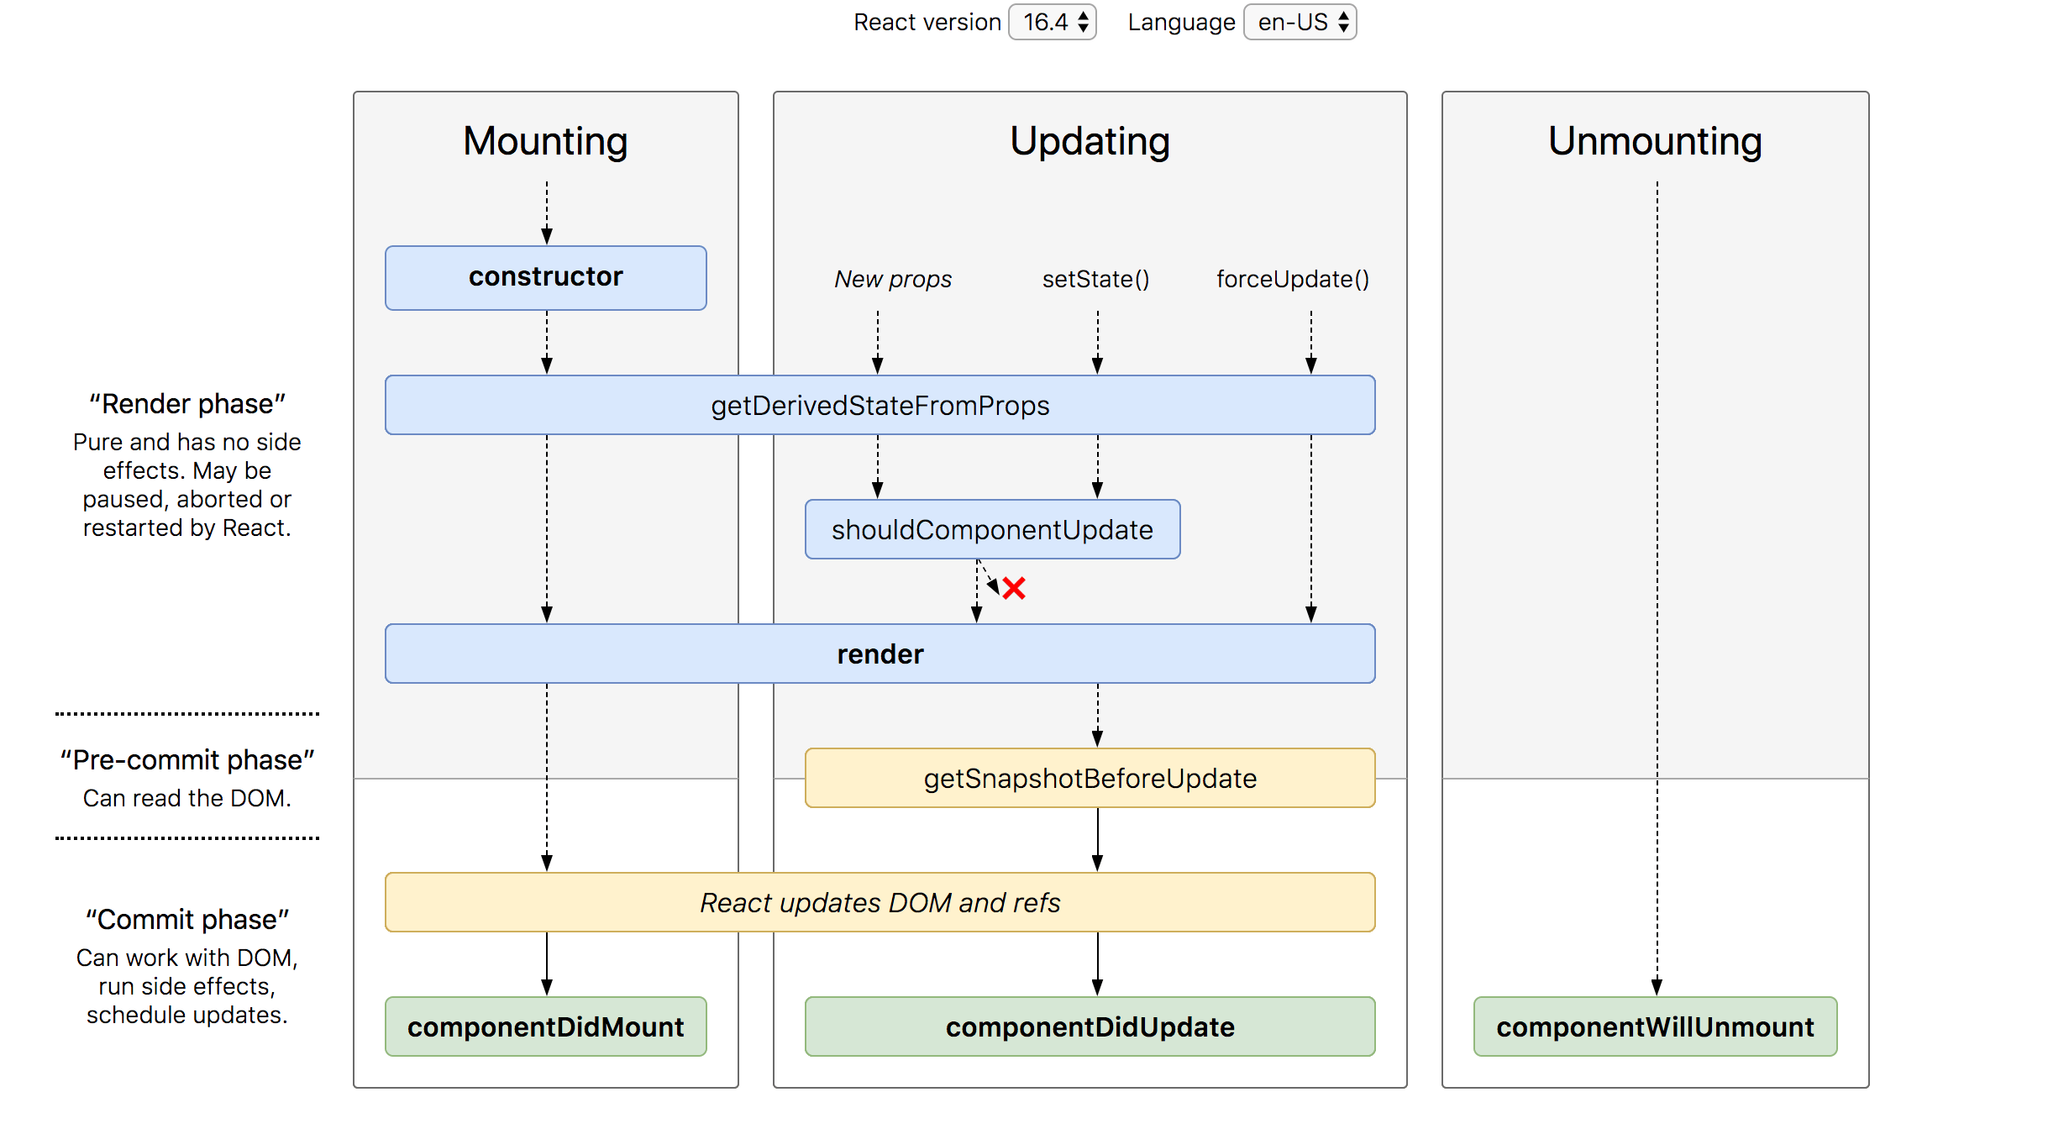
Recap

